Slide 1

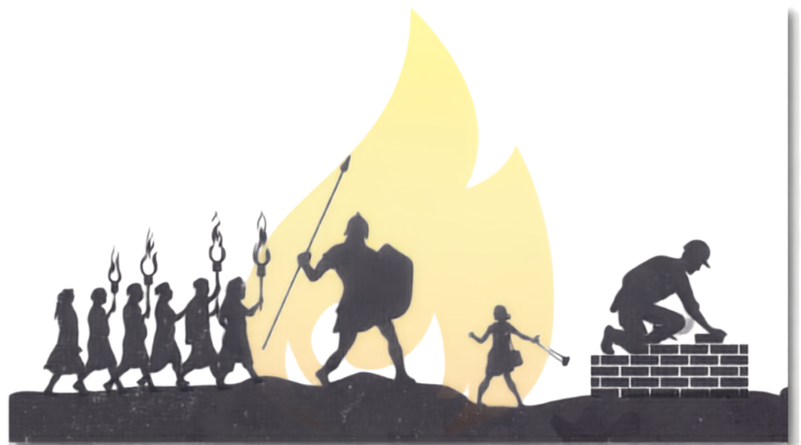
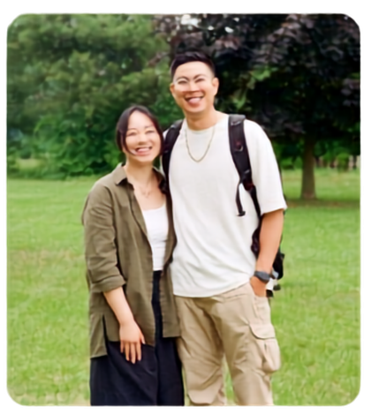
FAMILY LIFE CONFERENCE 2026
COMMISSIONED
COVENANT CARRIERS | GIANT SLAYERS | GENERATIONAL BUILDERS
PASTORS JEFF & ELLEN ABIERA

Slide 2

The Purpose of Carrying God’s Covenant Promises Together
Psalm 78:4
“We will not hide them from their descendants; we will tell the next generation the praiseworthy deeds of the Lord, his power, and the wonders he has done.”

Slide 3
Joshua 1:3
“Every place that the sole of your foot will tread upon I have given to you, just as I promised to Moses.”

Slide 4
Psalm 100:5
“For the Lord is good and his love endures forever; his faithfulness continues through all generations.”

Slide 5
Broken & Compromised Covenants
Saul Tries to Kill David
1 Samuel 19
There are more giants in the land to be conquered
2 Samuel 21:15-22 NLT

Slide 6
3 things that the enemy is still capable of doing even though he knows he’s going to lose.
    DISTRACT (make you take your eyes off of God)
    DESENSITIZE (hit you with those familiar spirits to make sure that you don’t recognize or have the awareness of something damaging you)
    DISCOURAGE (he’s going to try to make you lose hope)

Slide 7
God doesn’t promise that we won’t have any battles, but He does promise a victory!
Psalm 91 | Psalm 23

