Slide 1



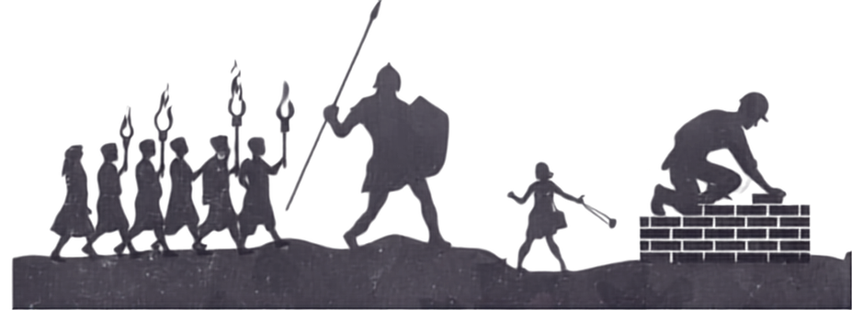
COMMISSIONED
FAMILY LIFE CONFERENCE 2026
COVENANT CARRIERS | GIANT SLAYERS | GENERATIONAL BUILDERS
DR. STEPHANIE OLIVER
WISDOM WORKSHOP

Slide 2




We are in the Redemption Arc

Slide 3
“Don’t just take your problems to God - take your life to Him.”
Mylon Lefevre

Slide 4
God wants to reveal Himself as REDEEMER.

Slide 5
Old Testament
Go'el (the redeemer/kinsman-redeemer),
Ga'al (the verb to redeem), and
Padah (to ransom or rescue)

Slide 6
New Testament
Romans 3:23-24 (NKJV)
“for all have sinned and fall short of the glory of God, being justified freely by His grace through the redemption that is in Christ Jesus,”

Slide 7
Romans 3:23-24 (TPT)
“for we all have sinned and are in need of the glory of God. Yet through his powerful declaration of acquittal, God freely gives away his righteousness.

Slide 8
His gift of love and favor now cascades over us, all because Jesus, the Anointed One, has liberated us from the guilt, punishment, and power of sin!”

Slide 9
Redemption: apolytrōsis
a releasing effected by payment of ransom
1. redemption, deliverance
2. liberation procured by the payment of a ransom

Slide 10
Joel 2:12-17
Rend your heart
• Release what is broken and in need of repair
• Return to the place of surrender

Slide 11
Joel 2:18-27
Receive the Refresh
• Let God water the land, and make it ready to produce
• Let it Rain and restore to you the years that the swarming locust has eaten.

Slide 12
Joel 1:28-32
Redemption is not just for our relief!
• God’s spirit is poured out so the kingdom of God can advance
• So that whoever calls on the name of the Lord Shall be Saved - Souls will see what the Lord has done - and there shall be deliverance as the
Lord has said!

Slide 13
We are in the Redemption Arc!
This is the time for us to align our hearts, our minds, to receive what God is pouring out.

Slide 14
REDEMPTION:::
(1) Removes fear.
1 John 4:18
(2) Restores loss
Joel 3:1, Joel 2:26
(Fullness restored/satisfaction)
(3) Removes shame
Joel 2:27
(4) Refreshes and Revives us with the Holy Spirit
Joel 2:28, Acts 2:16-17

Slide 15


