Slide 1

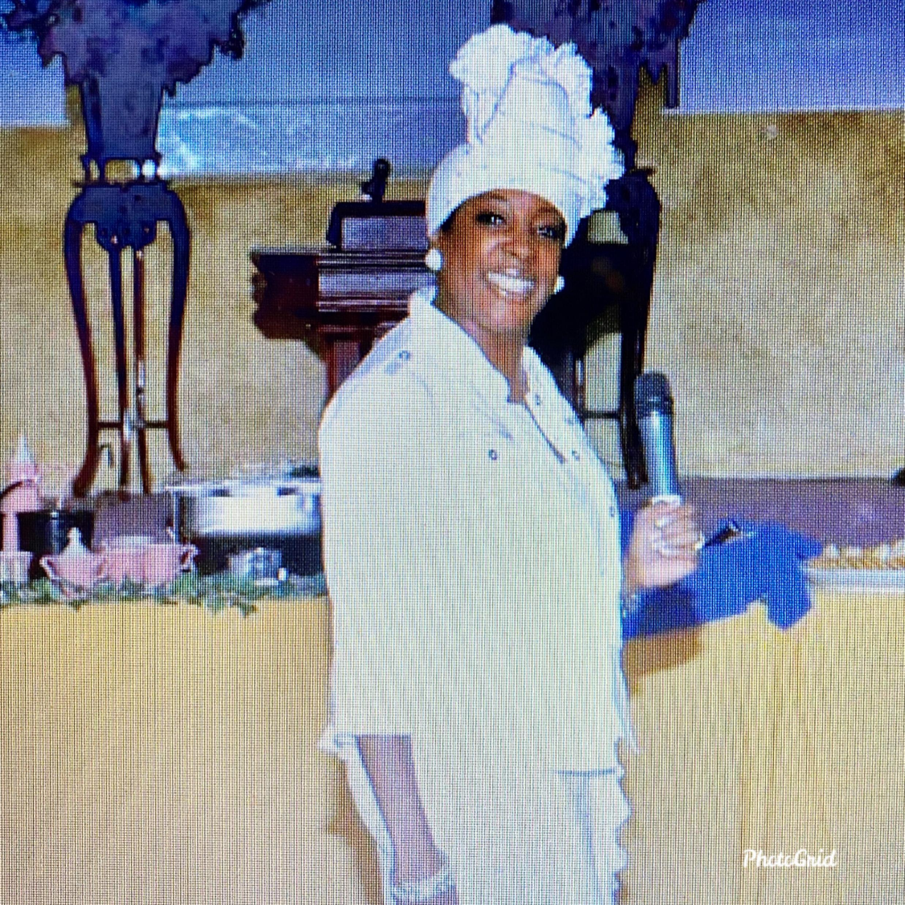

Slide 2
What Hinders You?
Facing & Confronting the UNRESOLVED
Family Life Conference 2026
Christian Life Center South Bend

Slide 3

Learning Objectives
Identify
Identify Hidden Unresolved Wounds
Understand
Understand How Trauma Affects Generations
Recognize
Recognize Barriers Preventing Healing
Learn
Learn Biblical Principles for Confronting Pain
Develop
Develop Practical Next Steps Toward Healing

Slide 4

Proverbs 4:7
Understanding
Involves not just knowing information but comprehending its context, relationships, and implications
True understanding allows for deeper insight and the ability to apply knowledge effectively

Slide 5

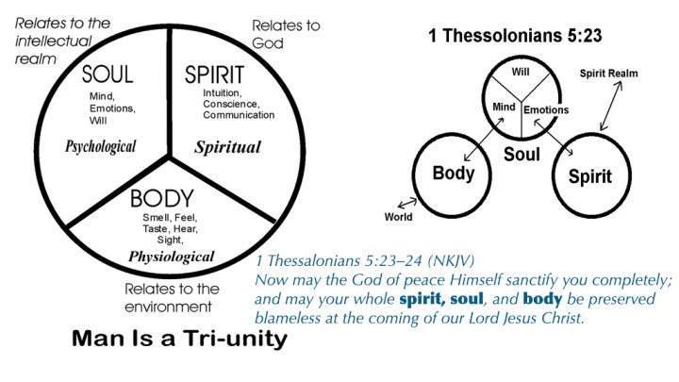
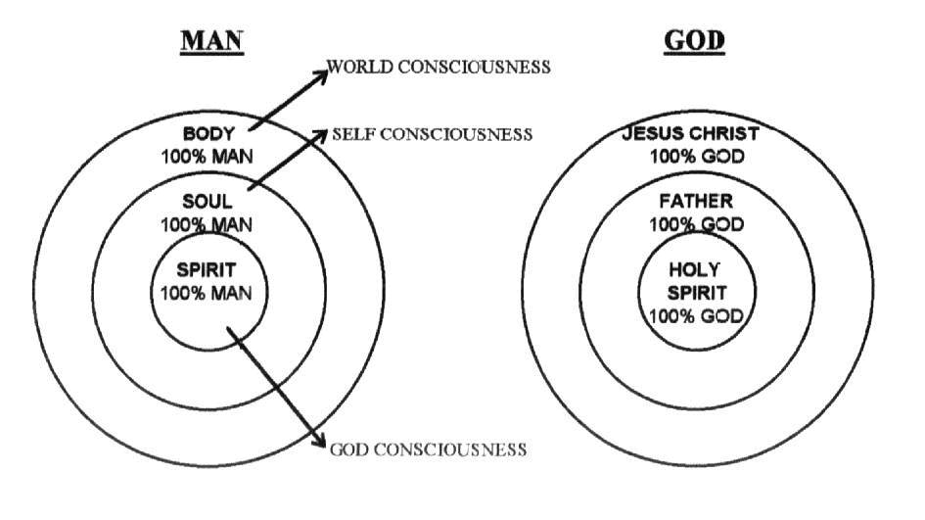

Slide 6
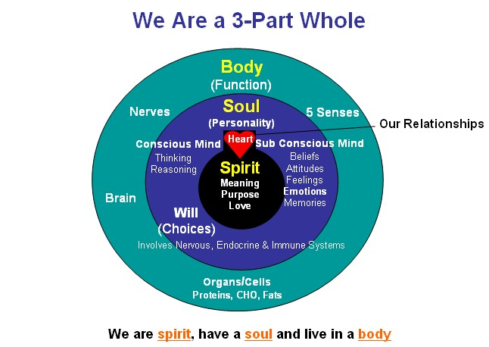

Slide 7
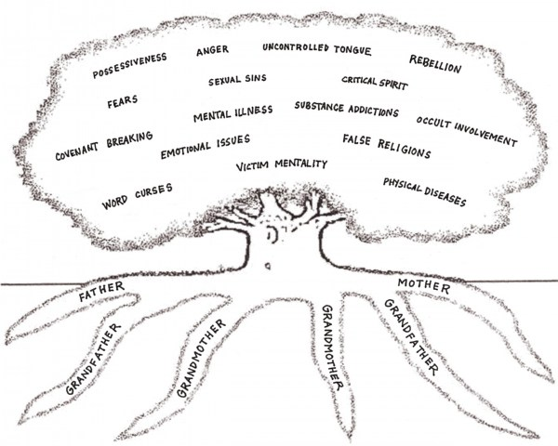
Trauma Tree
What keeps showing up in your life, even after you have prayed about it?
Fear? Anger? Rejection?
Addiction? Shame?
Family conflict?
Sometimes the problem isn't what happened...
It's what was never healed.

Slide 8

Why Do We Leave Things Unresolved?
Because...
"It hurts too much."
"I don't know how."
"My family never talked about emotions."
"I've been told to just pray."
"I thought time would heal it."
"I've become comfortable surviving."
Many people aren't avoiding healing...
They're avoiding pain.

Slide 9
Holy Spirit through Jesus Christ was sent to deliver those shattered by trauma
TYPE A
TYPE B
Absence of necessary good things:
Not being cherished/celebrated by parents; lack of nurture
Not given adequate food, clothing, shelter, basic care
Not receiving age-appropriate limits
Presence of bad things that happen:
Abuse (physical, sexual, mental, emotional); witnessing abuse
Spanking can become violent
Abandonment by parent

Slide 10
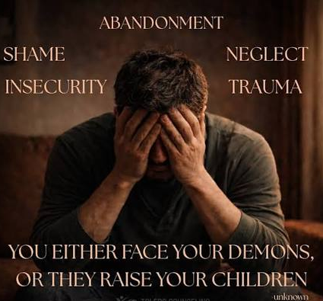
What Is
Unresolved Trauma?
Emotional, Psychological, or Spiritual pain that has never been fully processed…
Pain buried alive never dies.

Slide 11
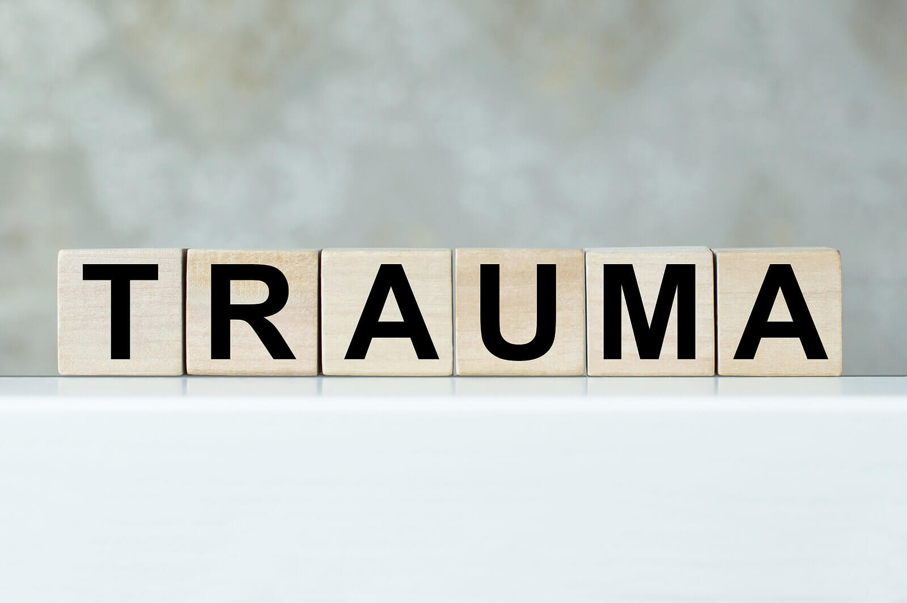
Examples of Unresolved Trauma
Childhood abuse
Abandonment
Divorce
Church Hurt
Grief
Racism
Betrayal
Domestic violence
Poverty
Neglect

Slide 12

Trauma doesn’t stay in the past…
Trauma affects:
  Brain
  Body
  Beliefs
  Behaviors
  Relationships
  Parenting
  Marriages
  Ministry/Churches
  Calling
  You may leave the event but the event hasn't left you
What isn’t transformed is often transferred.

Slide 13
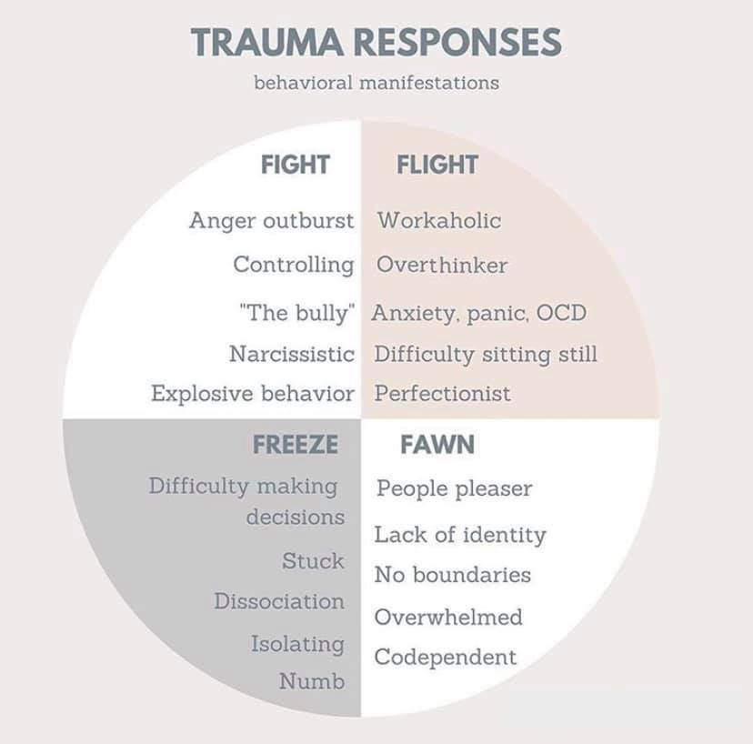
Your Brain Was Designed to Protect You
Trauma activates the brain's alarm system
Amygdala
Hippocampus
Prefrontal Cortex
When unresolved:
People begin living in survival instead of purpose.

Slide 14
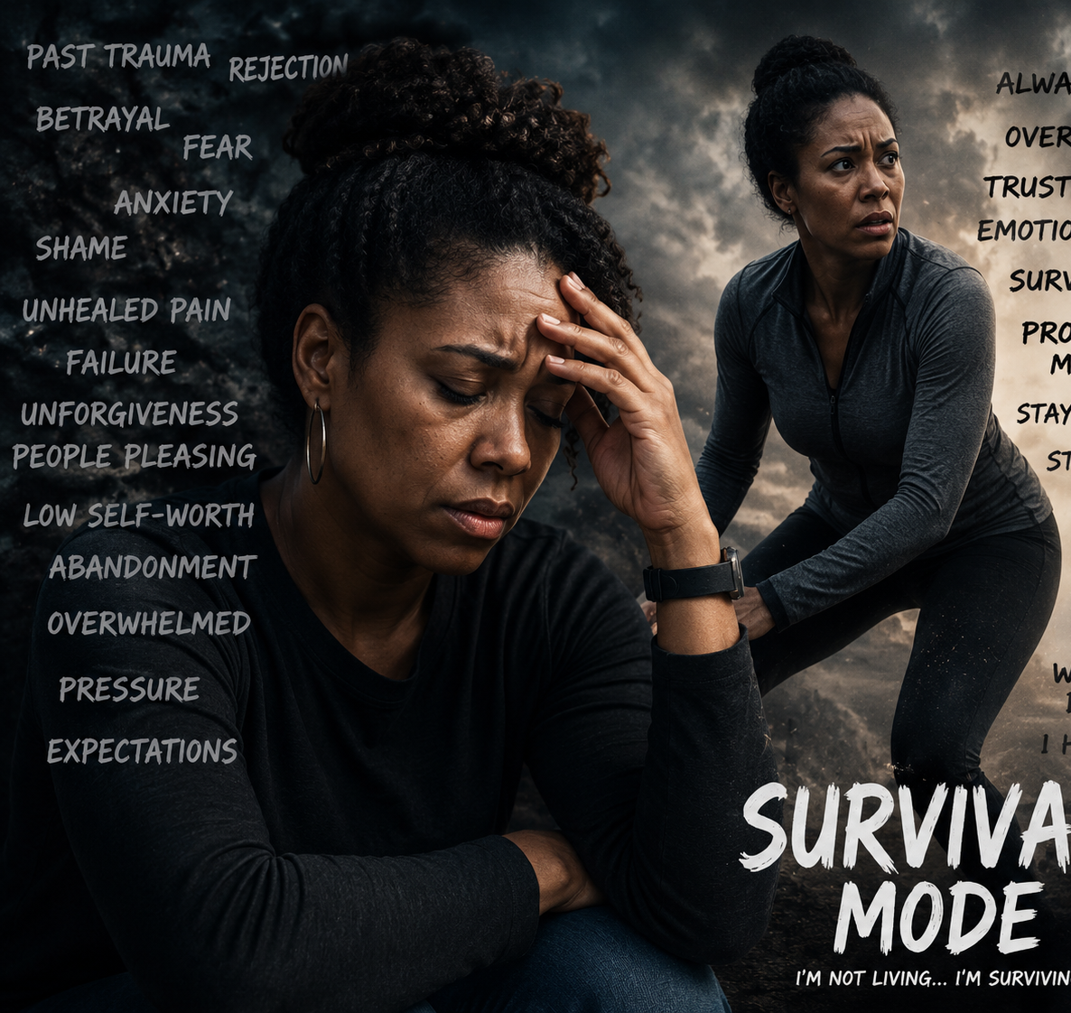
Signs of Survival Mode
Hypervigilance
Constant anxiety
Emotional numbness
Control issues
Isolation
Perfectionism
People pleasing
Difficulty trusting
The body remembers what the mind tries to forget.

Slide 15
What Hinders Families
Common hindrances:
Unforgiveness
Secrets
Shame
Pride
Fear
Bitterness
Silence
Generational trauma

Slide 16
The Weight We Carry
Hebrews 12:1
…let us lay aside every weight, and the sin which so easily ensnares us, and let us run with endurance the race that is set before us…
What are you carrying that God never intended for you to keep carrying?
Imagine hiking with a backpack filled with bricks
Many people live this way emotionally

Slide 17

Family Messages
People unconsciously receive messages
These become internal beliefs

Slide 18
Why Families Stay Stuck
Many families become experts at:
Keeping secrets
Avoiding conflict
Pretending everything is fine
Protecting unhealthy people
Normalizing dysfunction

Slide 19
What Hinders Families?
Common hindrances:
Unforgiveness, Betrayal
Grief, Losses Never Mourned
Shame
Pride
Fear
Bitterness
Silence
Generational trauma

Slide 20
Families Don't Just Pass Down DNA
They also pass down:
Beliefs
Behaviors
Secrets
Communication styles
Emotional responses
Conflict patterns
Faith
Fear
Hope
Shame
The question becomes:
What are YOU passing on?

Slide 21
Epigenetics
The study of how your environment, experiences, and behaviors can affect the way your genes work--without changing the DNA sequence itself.
Think of your DNA as the hardware, and epigenetics as the software that tells it when to turn on, turn off, or adjust.
Examines how factors such as stress, trauma, nutrition, relationships, exercise, and other life experiences can affect how your genes function.
Our genes provide the blueprint, but our experiences help shape how that blueprint is expressed.
Notes:
Acts 14:8 someone pull it up & read it for me; a cripple from his mother’s womb! For many of you, your trauma began in the womb! ME!

Slide 22
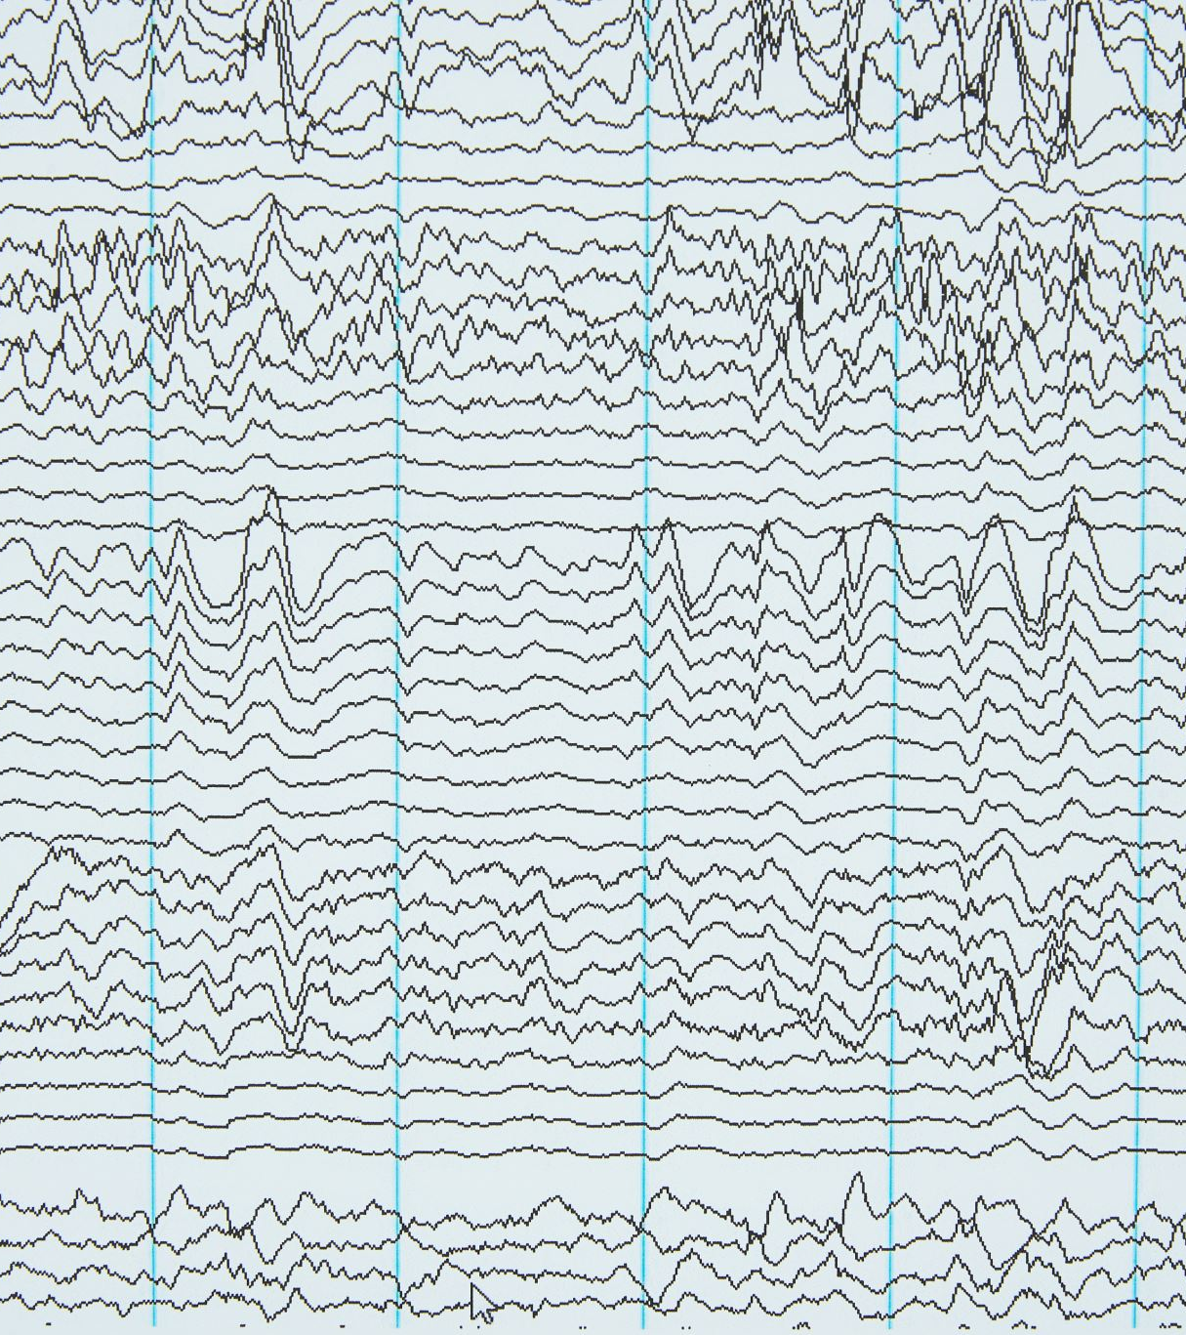
Generational Patterns
Genesis 26
Abraham lied
Isaac lied
Patterns repeat until someone interrupts them

Slide 23
How Things Pass Through the Bloodline or DNA
Exodus 20:5-6
Numbers 14:18
Research has shown that certain experiences, especially trauma, can leave epigenetic marks on your DNA.
These marks can be inherited, meaning that what your grandparents or parents went through may affect your physical or emotional health today.
For example:
Children of Holocaust survivors have shown altered stress responses.
Generational patterns of addiction, depression, or anxiety often run in families, not just due to environment, but due to inherited biological and emotional imprinting.

Slide 24
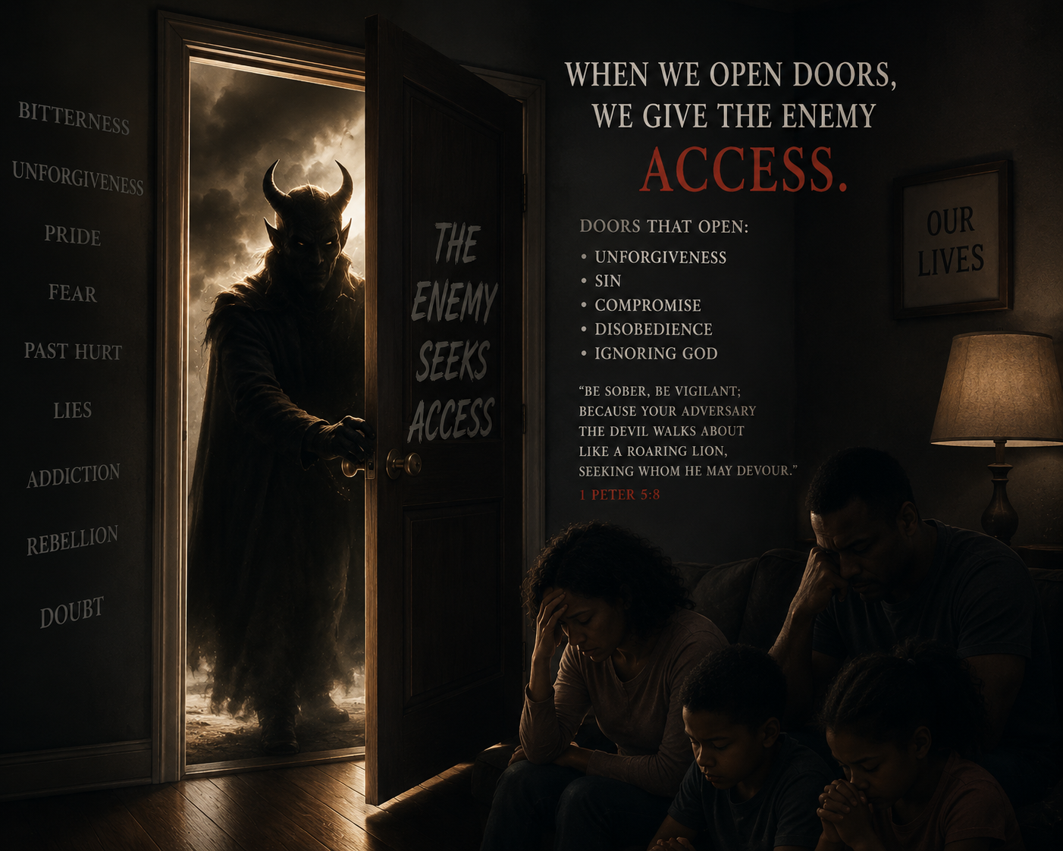
5 Open Doors Allow Satan Access
Dr. Henry Malone
Ancestral iniquities/Trauma – familiar spirits transmit to you the propensities from past generations (Exodus 20:5-6)
Disobedience
Unforgiveness
EMOTIONAL TRAUMA – grief hangs out here
Inner Vows & Judgements

Slide 25
Family Assignments Can Be Delayed
The enemy doesn't always attack the person...sometimes he attacks the family line:
Addiction
Suicide
Abuse
Divorce
Poverty mindset
Anger
Emotional absence

Slide 26
Hidden Signs You Are Still Wounded
Easily offended
Defensive
Need for control
Fear of abandonment
Constant busyness
Emotional shutdown
Difficulty receiving love

Slide 27

Church Doesn’t Automatically Heal Trauma
Prayer is essential
Deliverance is powerful
Counseling has value
Community matters
Healing involves all of these

Slide 28
Many People Cover Pain By Becoming…
Busy
Successful
Funny
Religious
Helpful
Strong
Independent
Yet still wounded
Covered pain eventually leaks

Slide 29
Confronting the Unresolved
Facing is awareness
Confronting is action
Confronting requires courage
You confront by:
Naming it
Talking about it
Grieving it
Forgiving
Setting boundaries
Seeking wise counsel
Renewing your thinking
Choosing healing
Healing begins when honesty begins
You cannot heal what you refuse to reveal…

Slide 30
Many Epigenetic Changes Are Reversible
Positive experiences can influence gene expression too:
Healthy relationships
Counseling and therapy
Exercise
Journaling
Quality sleep
Stress reduction
Prayer, worship, meditation on Scripture, and supportive faith communities
So, while you cannot change the DNA you inherited, you can often influence how those genes are expressed
Notes:
Good news – many are reversible!!!

Slide 31
Family Systems
Children learn:
How to love
How to argue
How to grieve
How to forgive
How to communicate
How to survive
Healing one person can influence generations
One healed parent, grandparent, sibling…

Slide 32
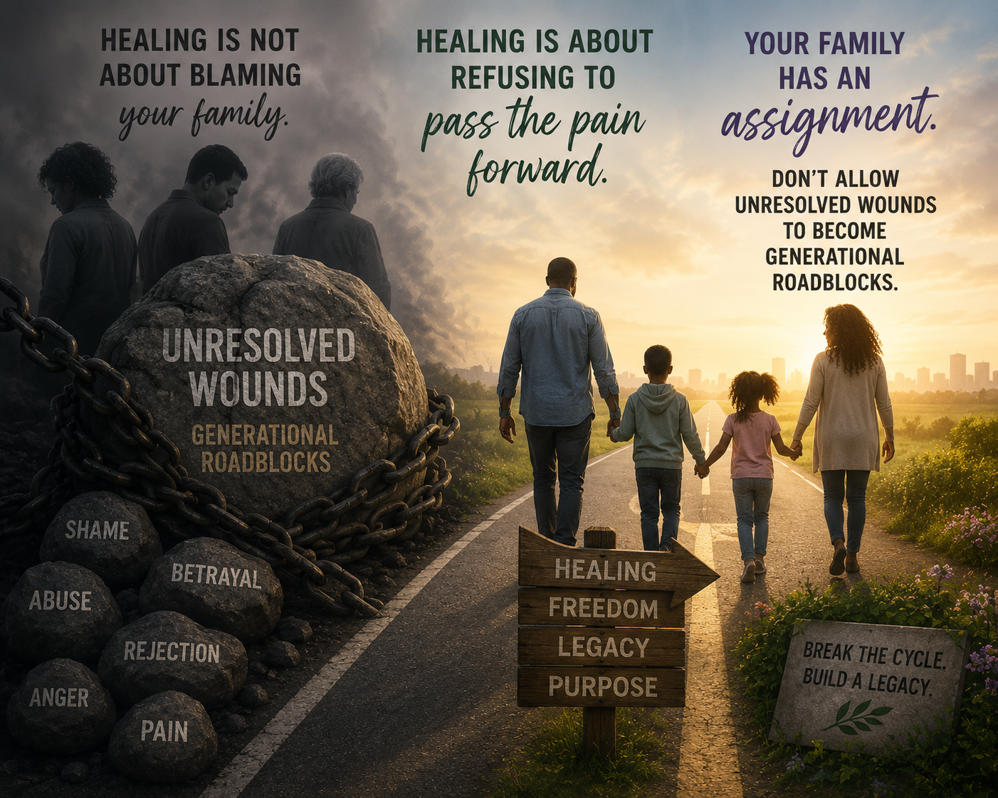

Slide 33
Thank you for your time & attention!
RIGHT NOW: Take a moment and write one concrete step you will take today to begin breaking an unhealthy pattern.
HOMEWORK: Answer the questions on the Handout:
‘Questions That Reveal the Unresolved in Your Life’

