Slide 1







Wisdom Wins Every Time!!
Building Generational Bridges
Ministers Frankie & Kori Merritt
COMMISSIONED
Covenant Carriers | Giant Slayers | Generational Builders

Slide 2



CROSSING THE JORDAN
Someone Must Step First
  The Jordan wasn’t just water. It was a boundary between the old and the promised.
  God called His people to step forward in faith.
  What boundaries is God calling your family to cross?
“Arise, consecrate yourselves, for tomorrow the LORD will do amazing things among you.”
Joshua 3:5
COMMISSIONED
Covenant Carriers | Giant Slayers | Generational Builders

Slide 3
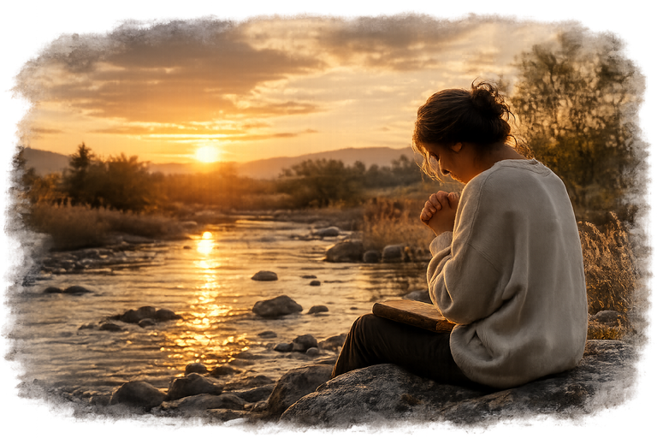
CONSECRATE YOURSELVES
Prepare Your Heart
  It’s a decision to focus on God and His purposes.
  Preparation isn’t just physical, it’s spiritual. Clean heart. Clear mind. Unified faith.
  When we prepare together, God moves mightily.
COMMISSIONED
Covenant Carriers | Giant Slayers | Generational Builders

Slide 4
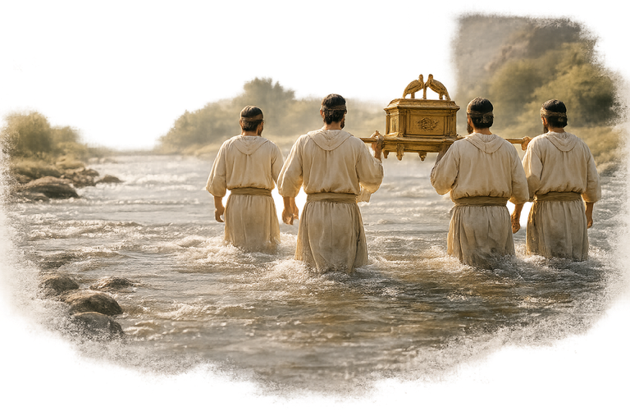
THE PRIESTS STEP INTO THE WATER
Faith Before the Miracle
  The priests didn’t wait for the water to stop. They stepped in first.
  Faith means moving when you can’t see the whole picture.
  Our obedience is the
trigger for God’s miracle.
“And the priests who carried the ark of the covenant of the LORD stepped into the Jordan.”
Joshua 3:15
COMMISSIONED
Covenant Carriers | Giant Slayers | Generational Builders

Slide 5
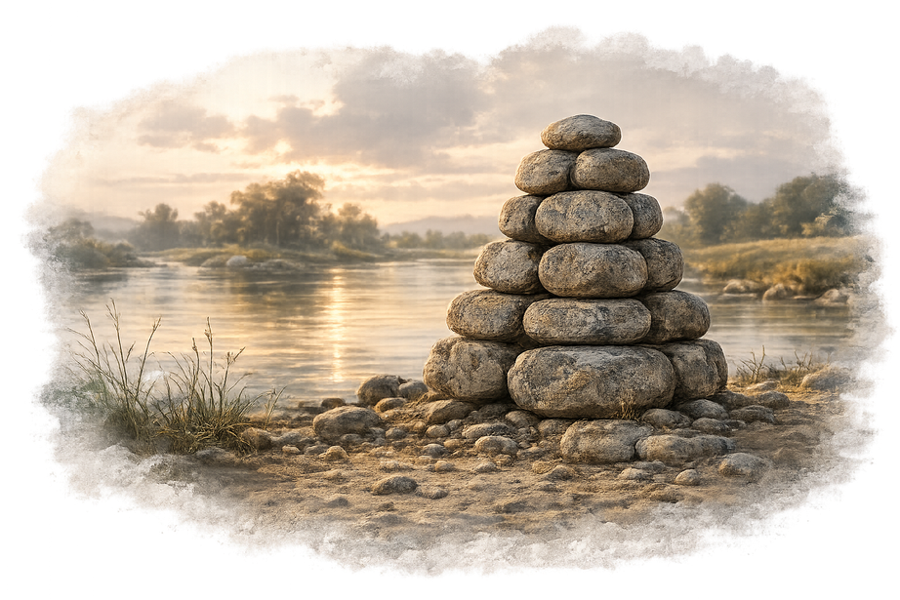
THE TWELVE STONES
Build Memorials
  God told Joshua to set up stones as a memorial.
  Memorials help future generations remember God’s faithfulness.
  What memorials of God’s faithfulness will your family build?
COMMISSIONED
Covenant Carriers | Giant Slayers | Generational Builders

Slide 6
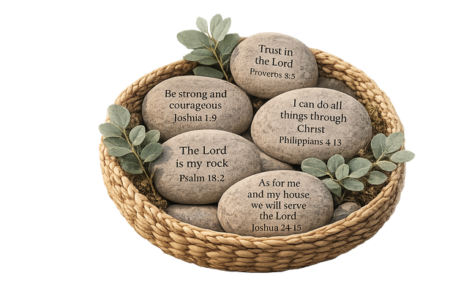











INTERACTIVE
Scripture Stone Activity
A simple way to build Generational Faith:
1
2
3
4
HOLD
YOUR STONE
TALK
TOGETHER
PRAY
TOGETHER
Read the verse
and let it speak
to your heart.
Share what the verse means to you and your family.
Ask God to write His truth on your hearts as a family,
May this become a conversation, not just a decoration...
COMMISSIONED
Covenant Carriers | Giant Slayers | Generational Builders

Slide 7
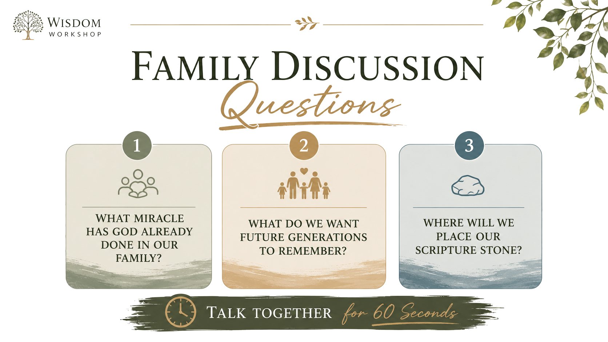
FAMILY DISCUSSION
Questions
COMMISSIONED
Covenant Carriers | Giant Slayers | Generational Builders

Slide 8













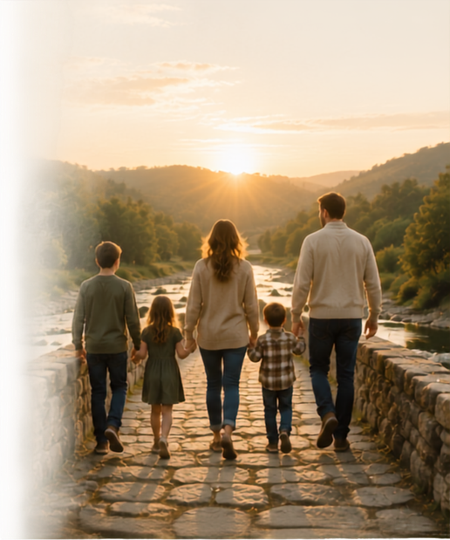



OUR FAMILY LEGACY
“What Will Our Children Remember?”
THEY COULD REMEMBER
THEY COULD REMEMBER
FEAR
FAITH
ANGER
OR
HOPE
PRAYER
SILENCE
GRACE
BITTERNESS
LOVE
COMMISSIONED
Covenant Carriers | Giant Slayers | Generational Builders

Slide 9


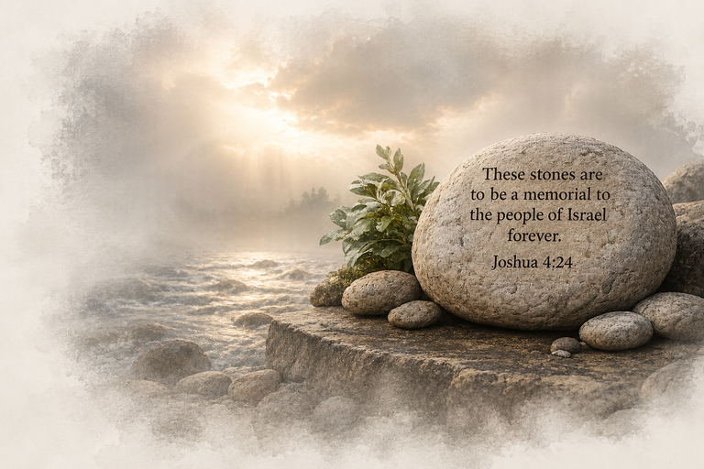
JOSHUA 4:24
God’s Faithfulness Across Generations
"He did this so that all the peoples of the earth might know that the hand of the Lord is
powerful and so that you might always fear the Lord your God."
Joshua 4:24
COMMISSIONED
Covenant Carriers | Giant Slayers | Generational Builders

Slide 10
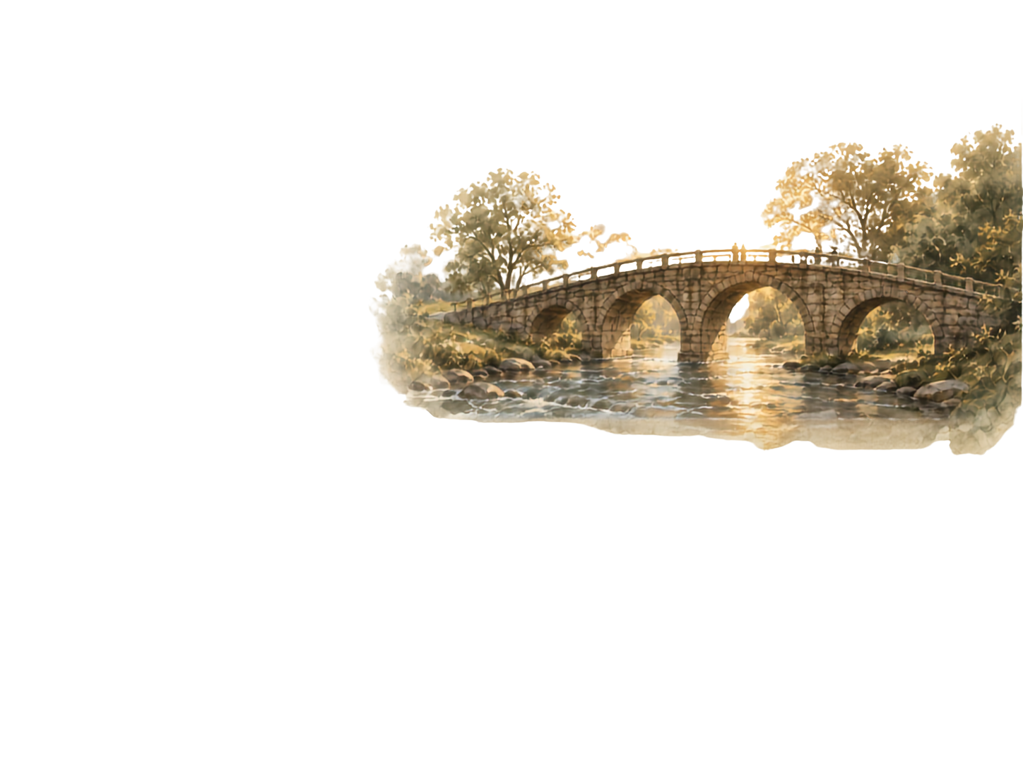
CLOSING CHALLENGE
Be the Bridge for the Next Generation
The legacy we leave begins with the choices we make today.
COMMISSIONED
Covenant Carriers | Giant Slayers | Generational Builders

